Slide 1
Power Blocks
Giving Students the Power to Define Their Learning Experience
Chris Sakurada
Hayden Seto
Jeffrey Anderson

Slide 2
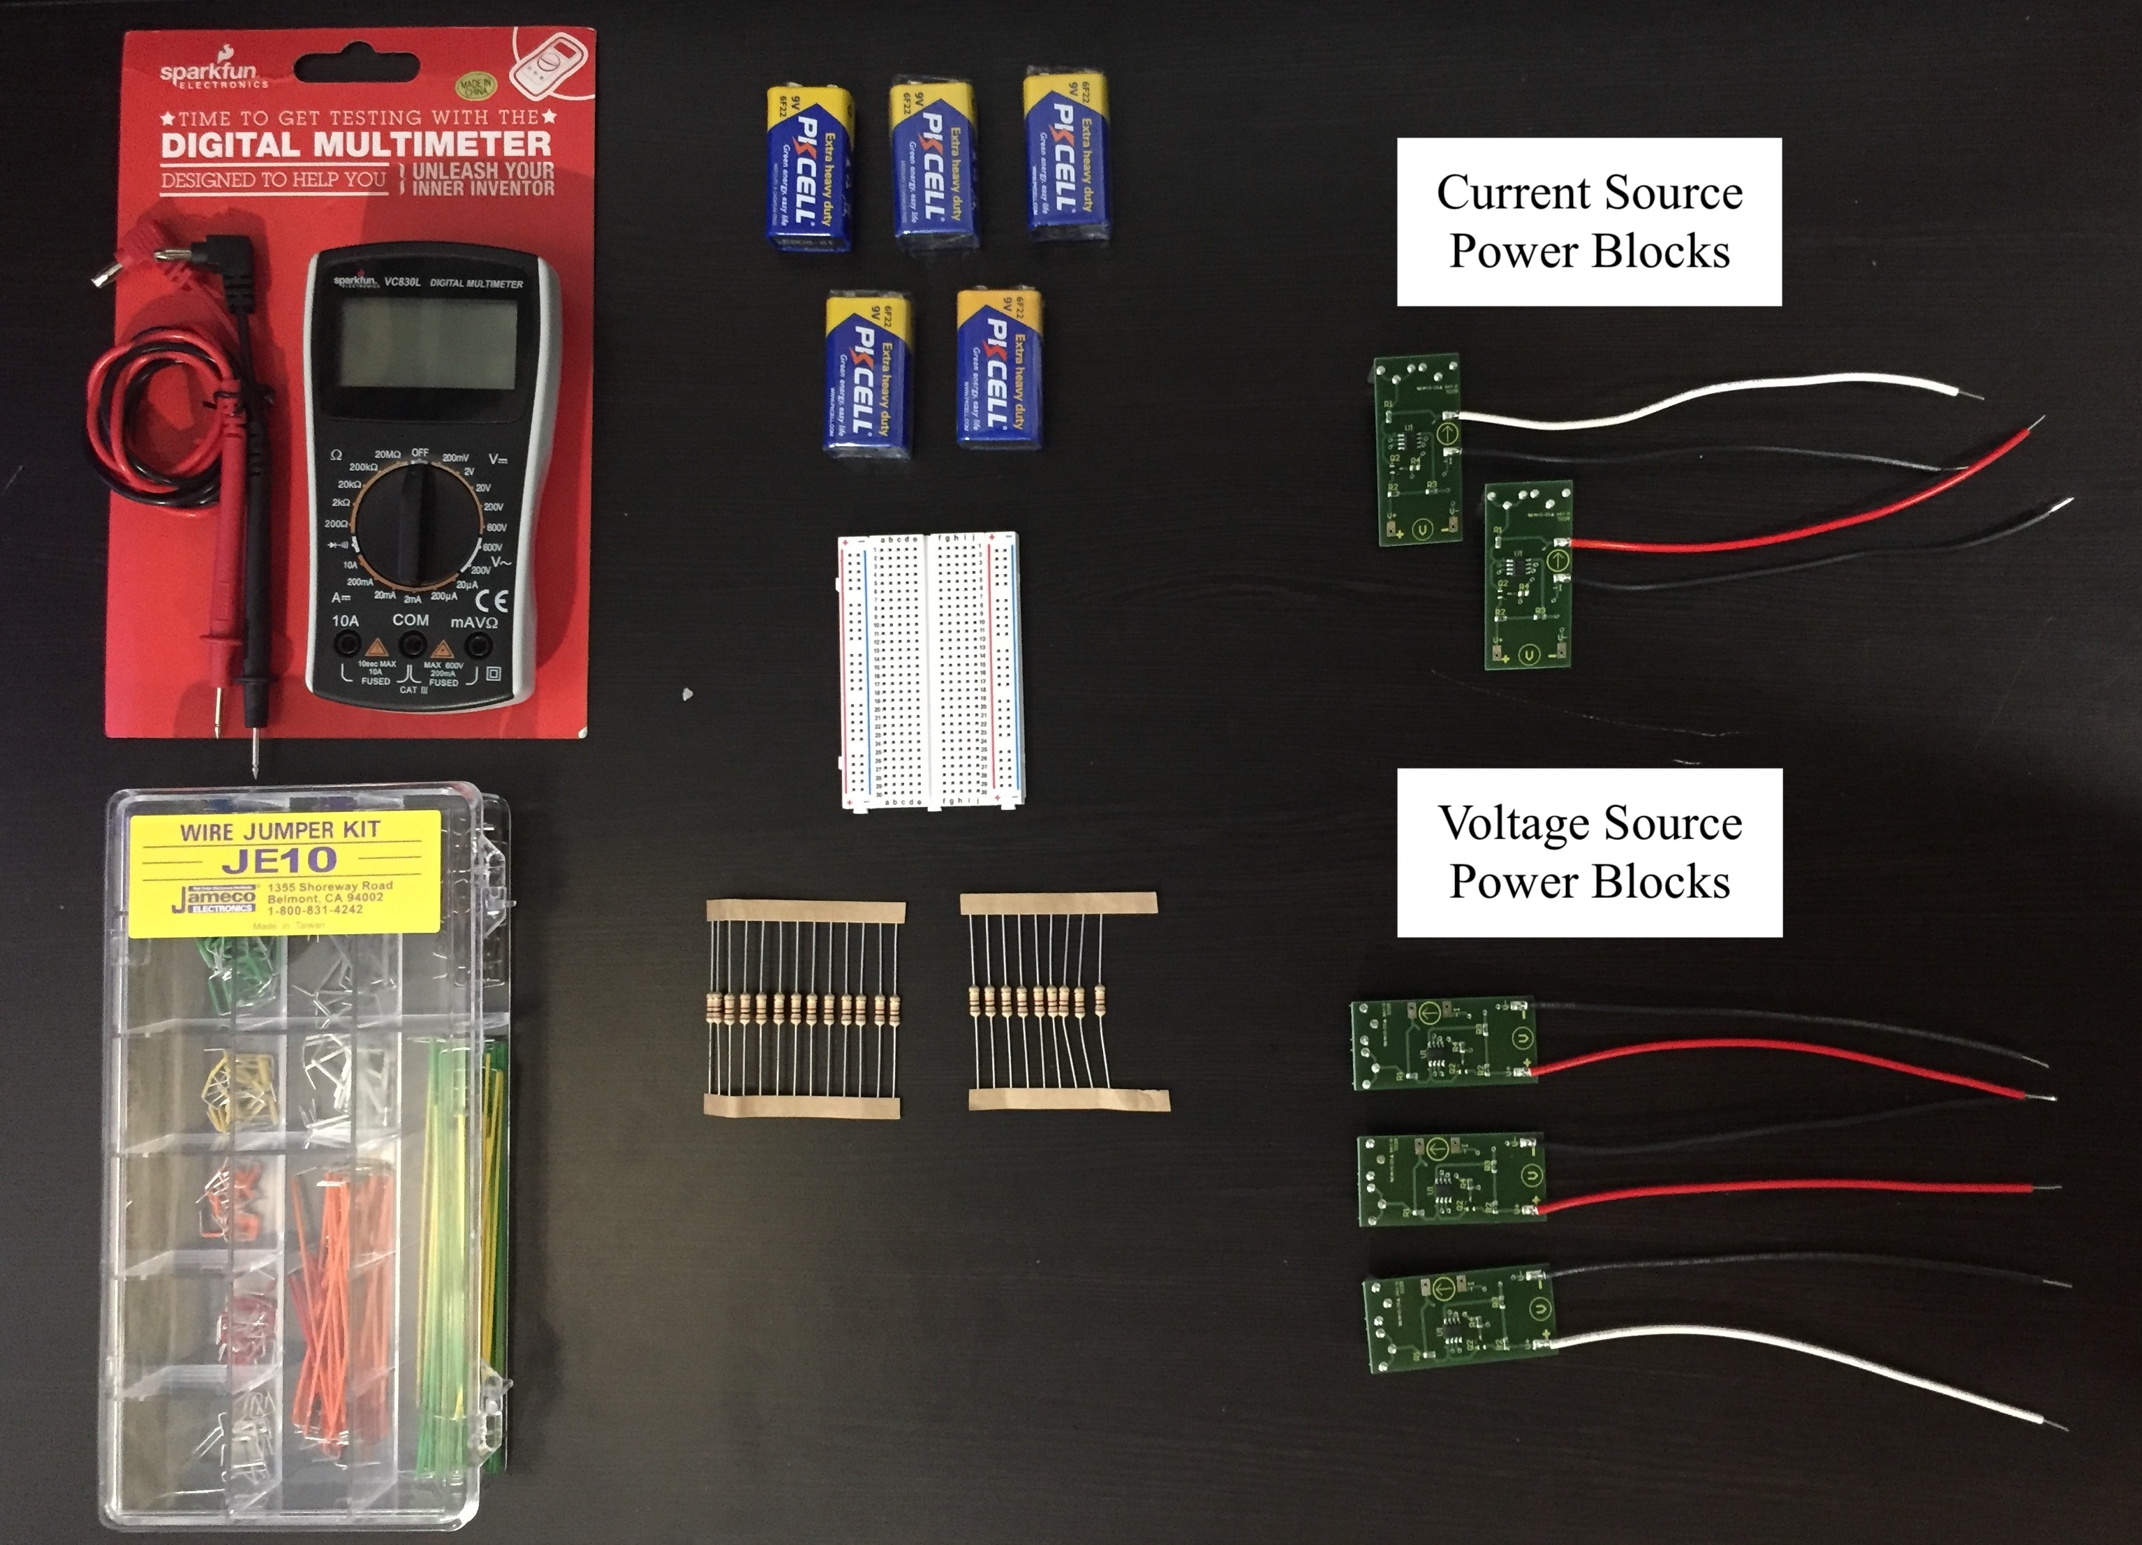
Electronics Learning Lab Kits

Slide 3
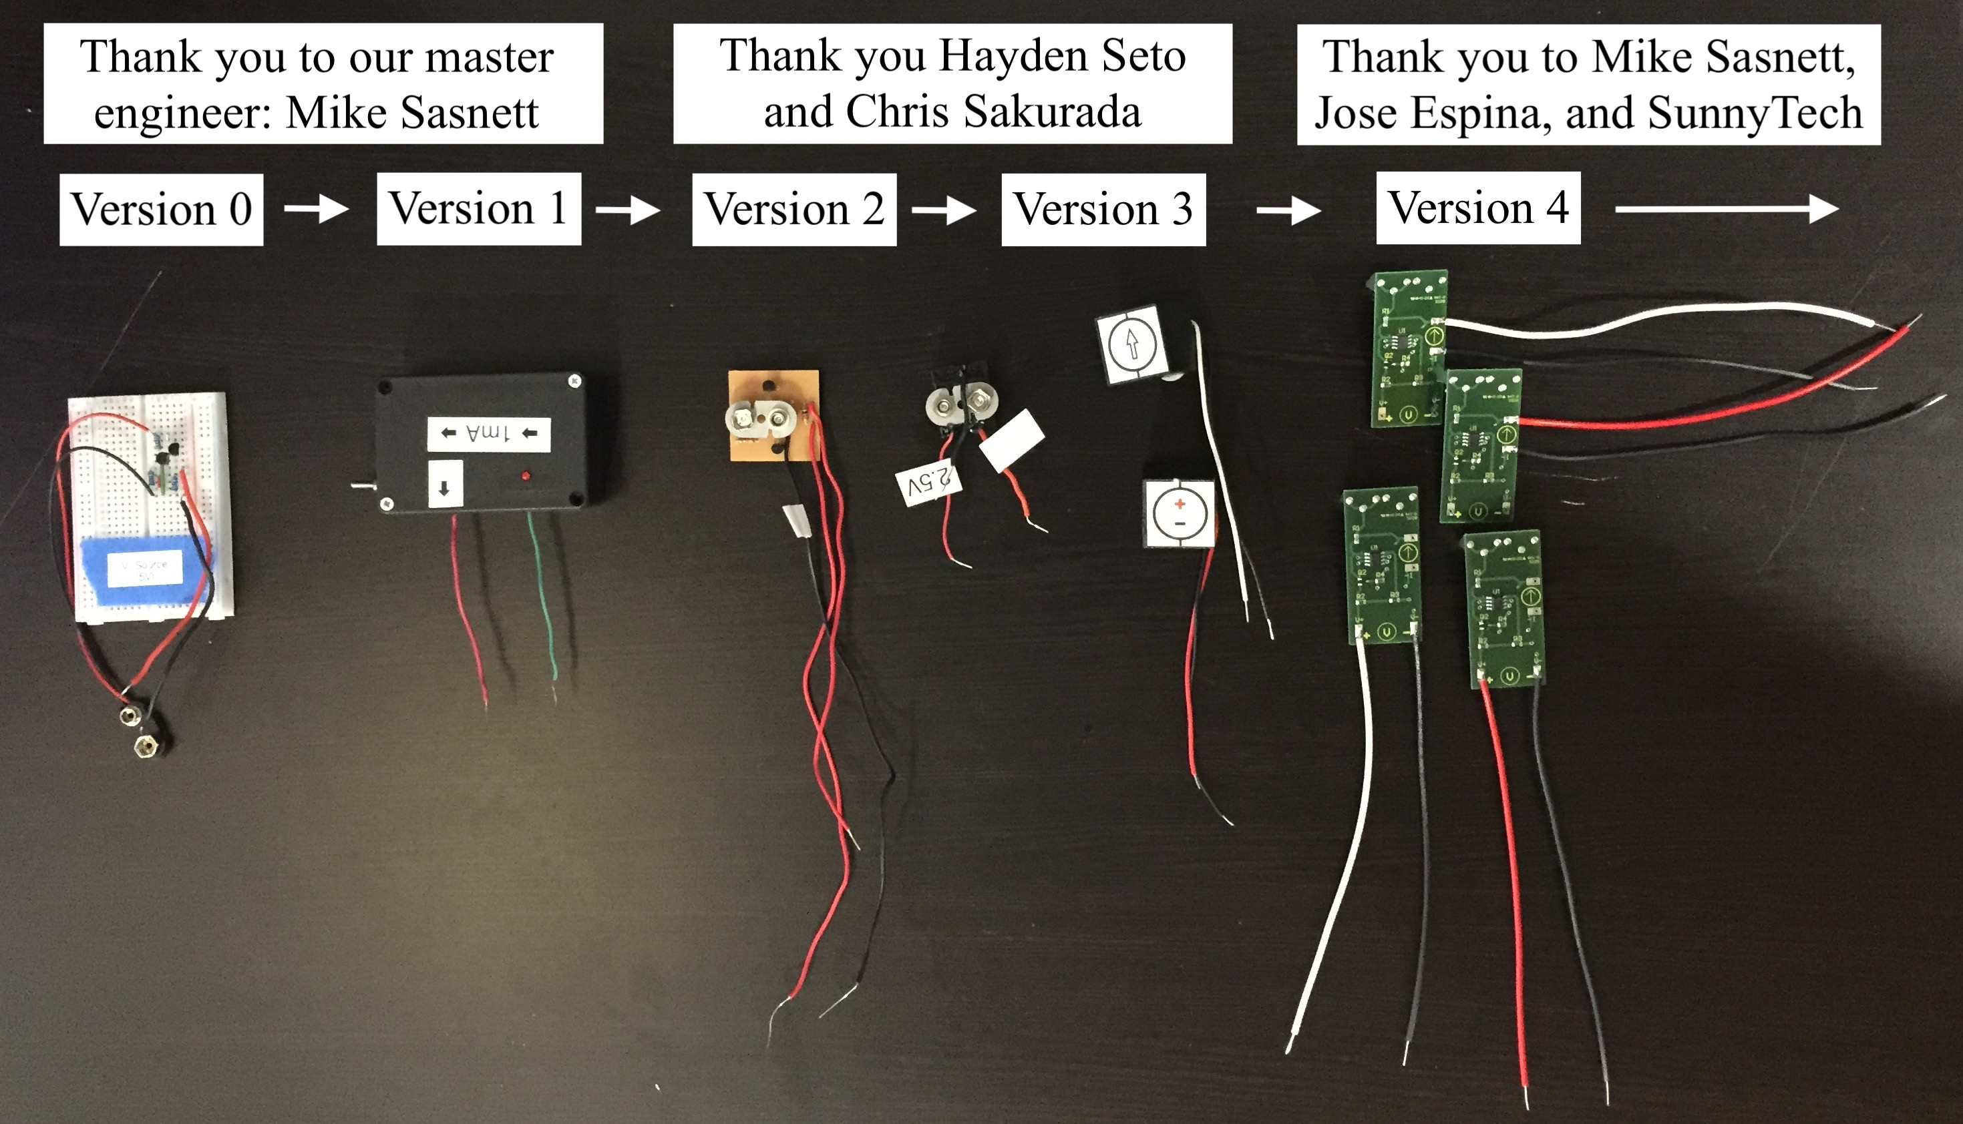
P-Block Project Overview

Slide 4
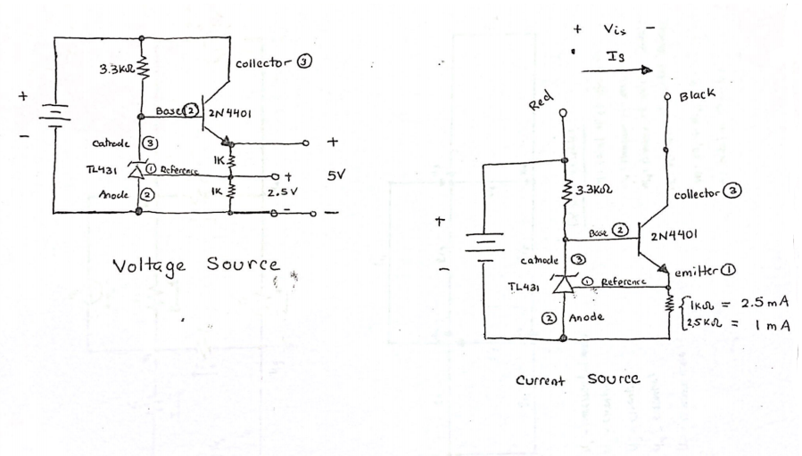
Initial Design
Prototype
Materials
Schematic Capture
Milled Assembly
Board Layout
Manufacturing
PCB Assembly
Packaging
Deployment
Improved Design
Impact
Initial Design

Slide 5
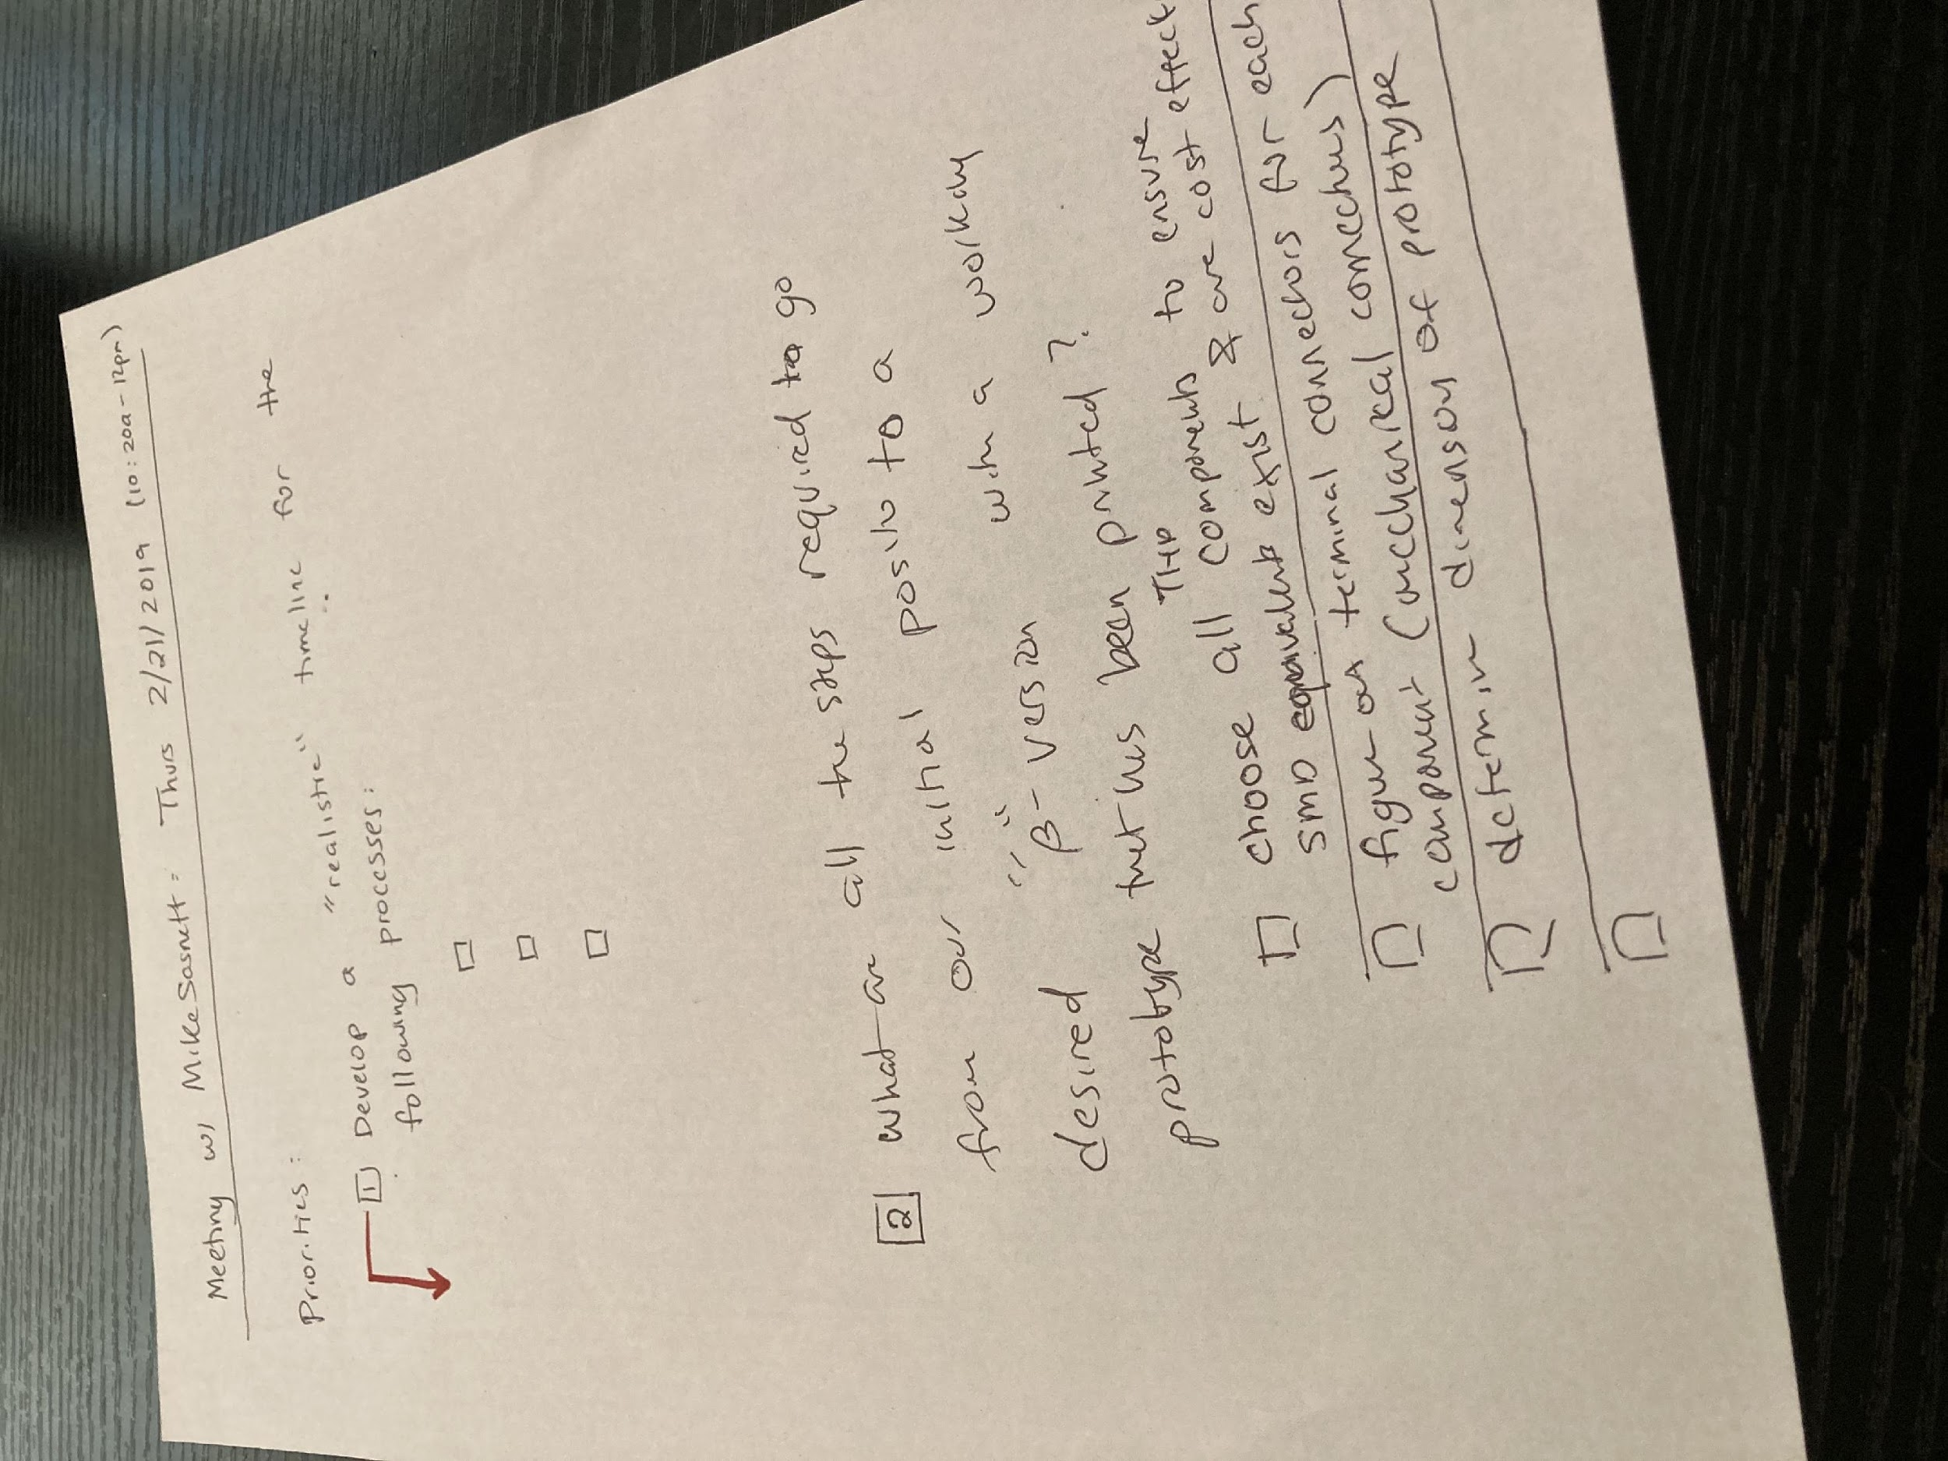
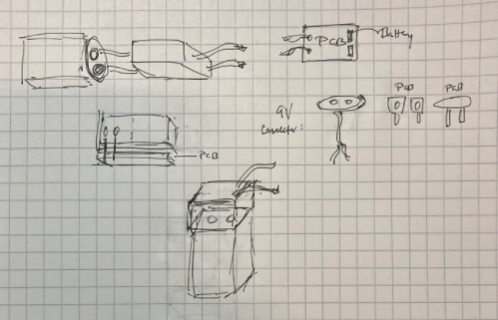
Initial Design
Prototype
Materials
Schematic Capture
Milled Assembly
Board Layout
Manufacturing
PCB Assembly
Packaging
Deployment
Improved Design
Impact
Prototype
Decide device requirements
Low cost
User friendly
As small as possible
Brainstorm Ideas:

Slide 6
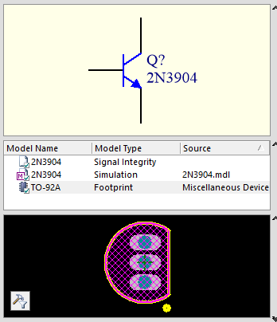
Initial Design
Prototype
Materials
Schematic Capture
Milled Assembly
Board Layout
Manufacturing
PCB Assembly
Packaging
Deployment
Improved Design
Impact
Materials
Component Selection:
Availability
Cost
Schematic Symbol
PCB Footprint
Components: | # of Units | Cost Per Unit | Total Component Cost:
Axial Resistor | 150 | 0.02928 | 4.38
Axial Resistor | 250 | 0.02144 | 5.36
Voltage Regulator | 150 | 0.2859 | 30.89
NPN Transistor | 150 | 0.0884 | 13.26
Keystone 9V | 150 | 0.94339 | 141.5
Hammond Enclosure | 150 | 0.58 | 87
Araldite 2011 epoxy | 1 | 150 | 150
PCB | 150 (75/75) |  | 36
22 AWG Wire | 3 | 14.3 | 43
 |  | Total Cost: | 511.39

Slide 7
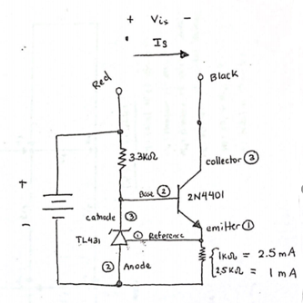
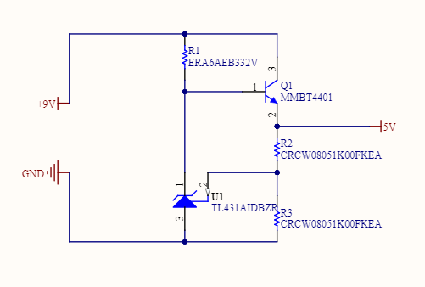
Initial Design
Prototype
Materials
Schematic Capture
Milled Assembly
Board Layout
Manufacturing
PCB Assembly
Packaging
Deployment
Improved Design
Impact
Schematic Capture
Current Source:

Slide 8
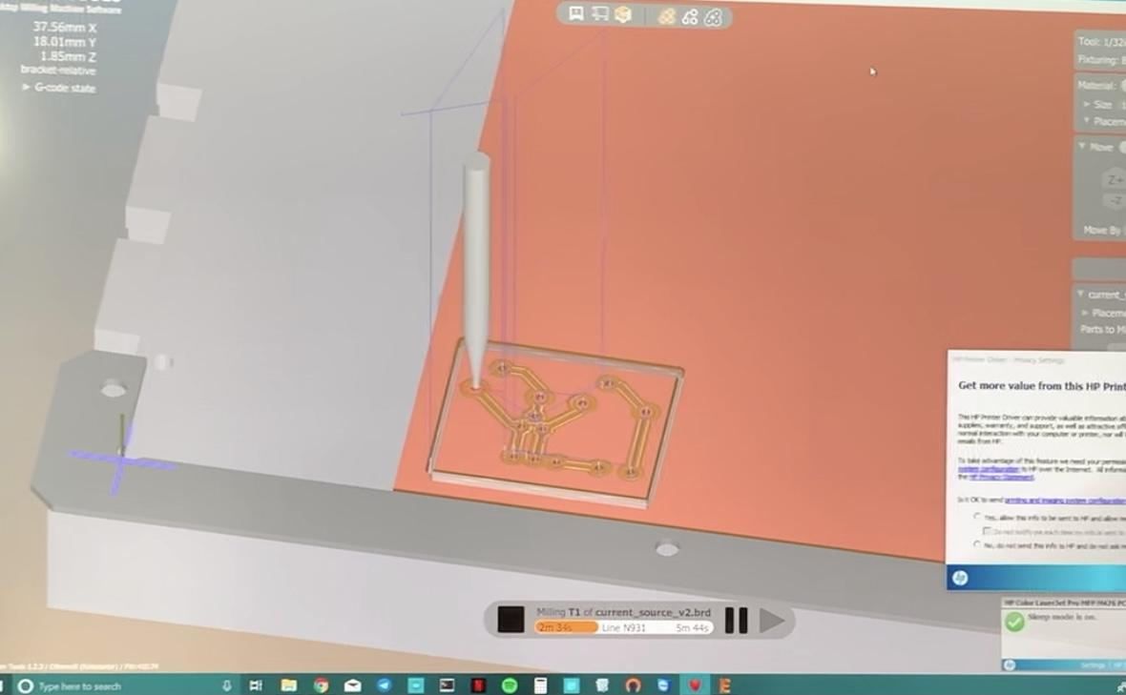
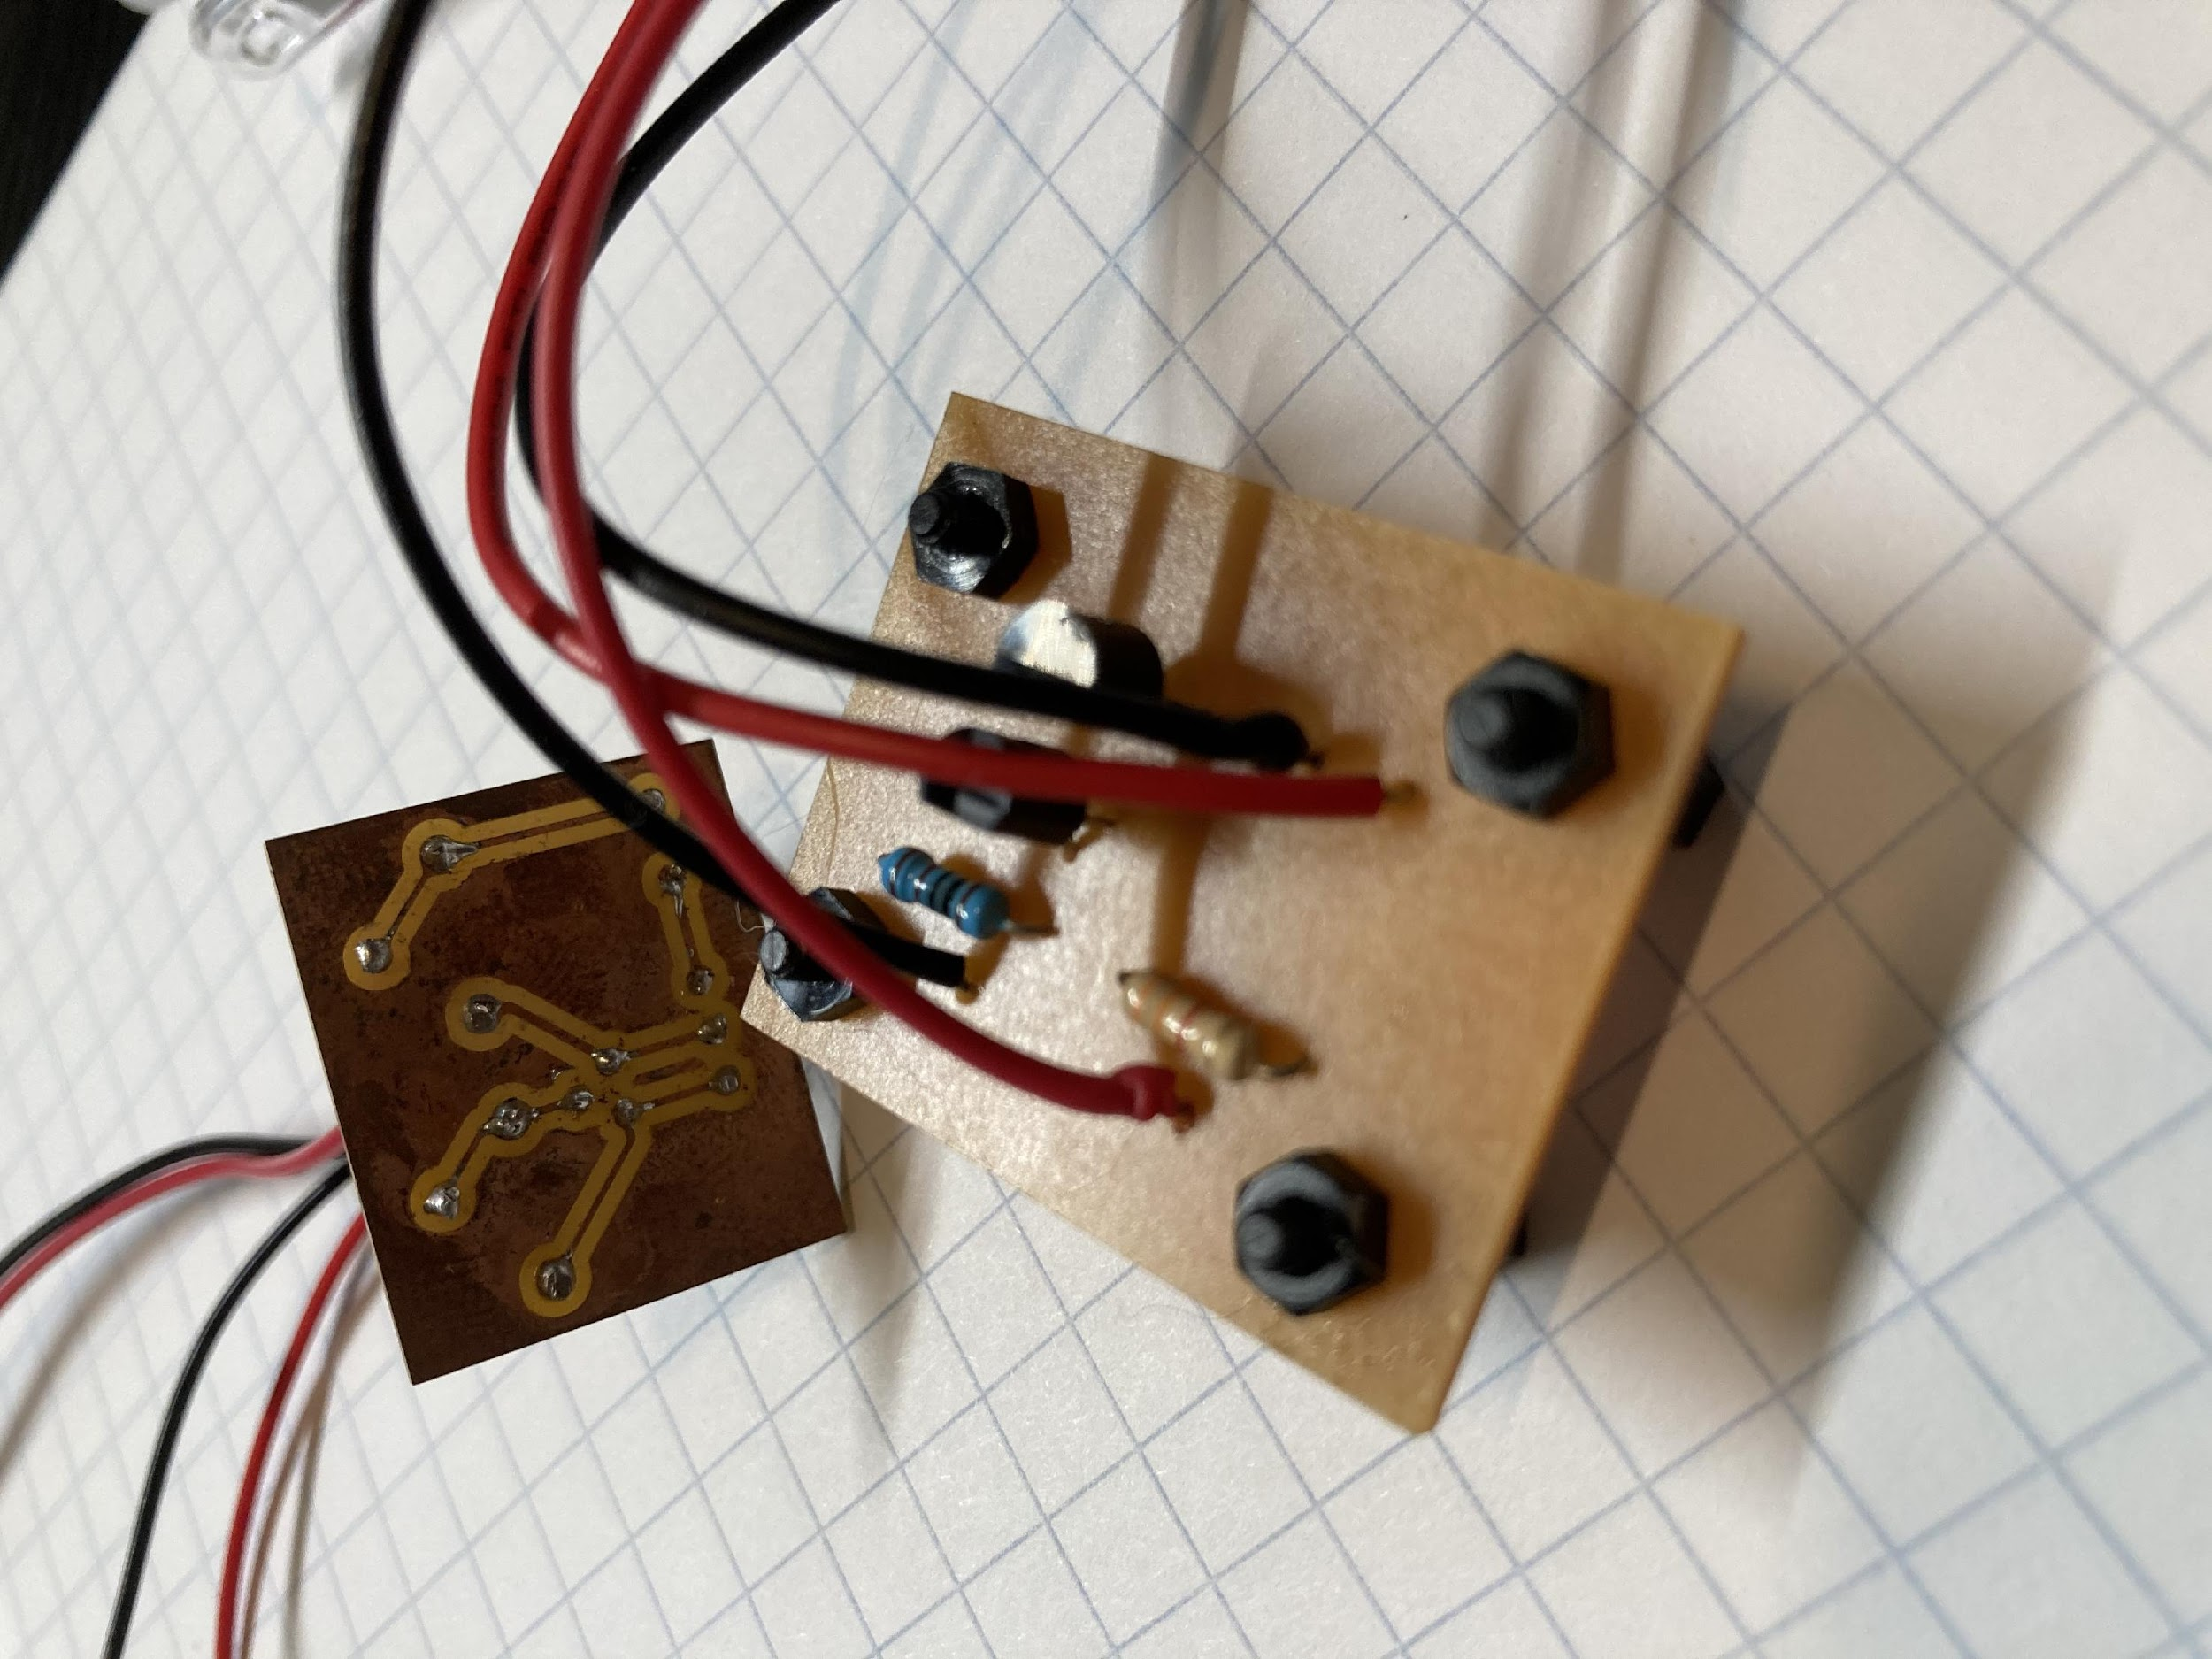
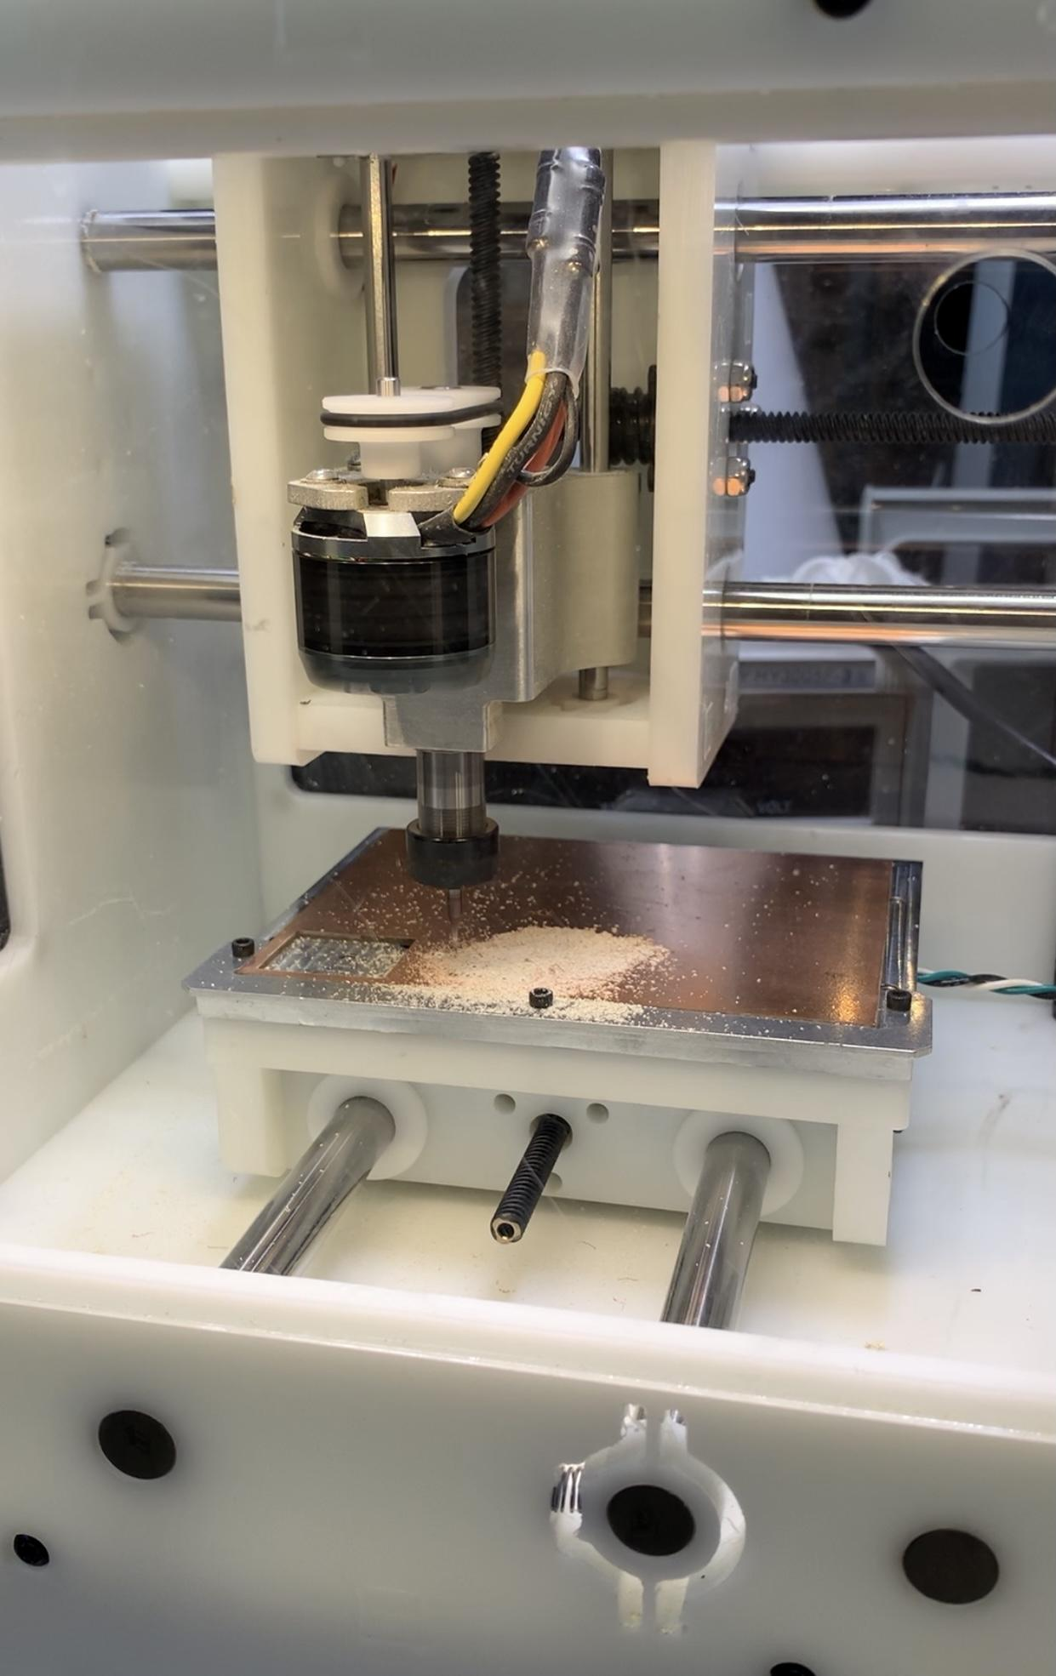
Initial Design
Prototype
Materials
Schematic Capture
Milled Assembly
Board Layout
Manufacturing
PCB Assembly
Packaging
Deployment
Improved Design
Impact
Milled Assembly
Provides a physical sense of dimension and verify schematic capture is successful

Slide 9
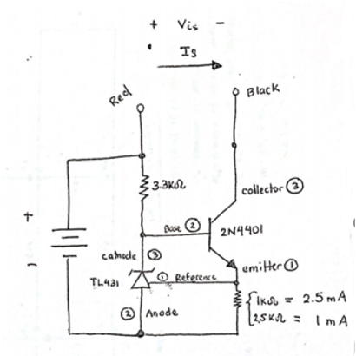
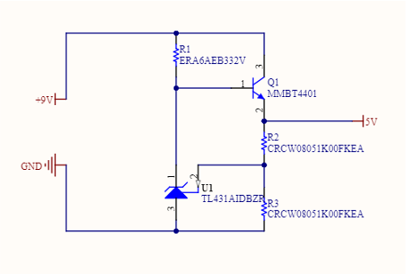
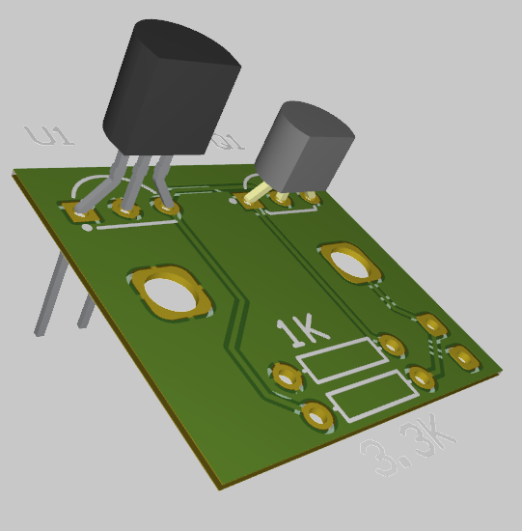
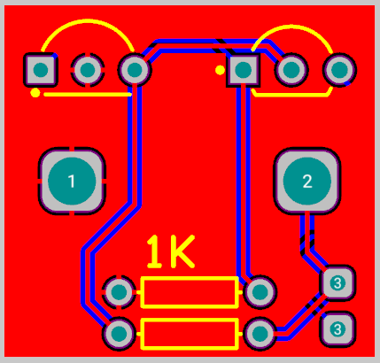
Initial Design
Prototype
Materials
Schematic Capture
Milled Assembly
Board Layout
Manufacturing
PCB Assembly
Packaging
Deployment
Improved Design
Impact
Board Layout
Source: https://techdocs.altium.com//cn/display/ADOH/Tutorial+-+Getting+Started+with+PCB+Design

Slide 10
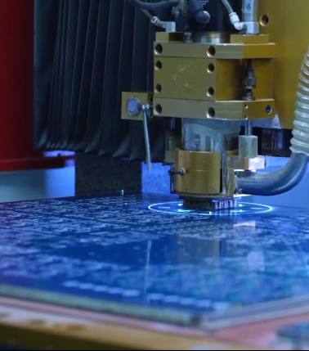
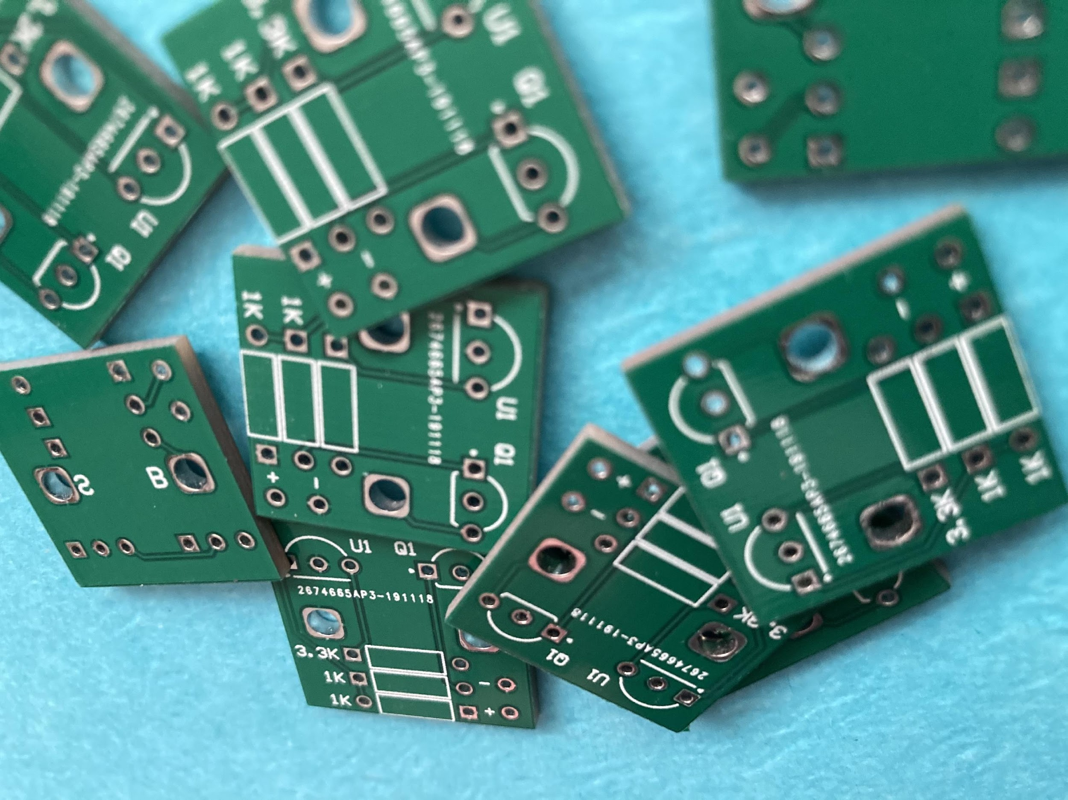
Initial Design
Prototype
Materials
Schematic Capture
Milled Assembly
Board Layout
Manufacturing
PCB Assembly
Packaging
Deployment
Improved Design
Impact
Manufacturing
Source: jlcpcb.com/aboutus

Slide 11
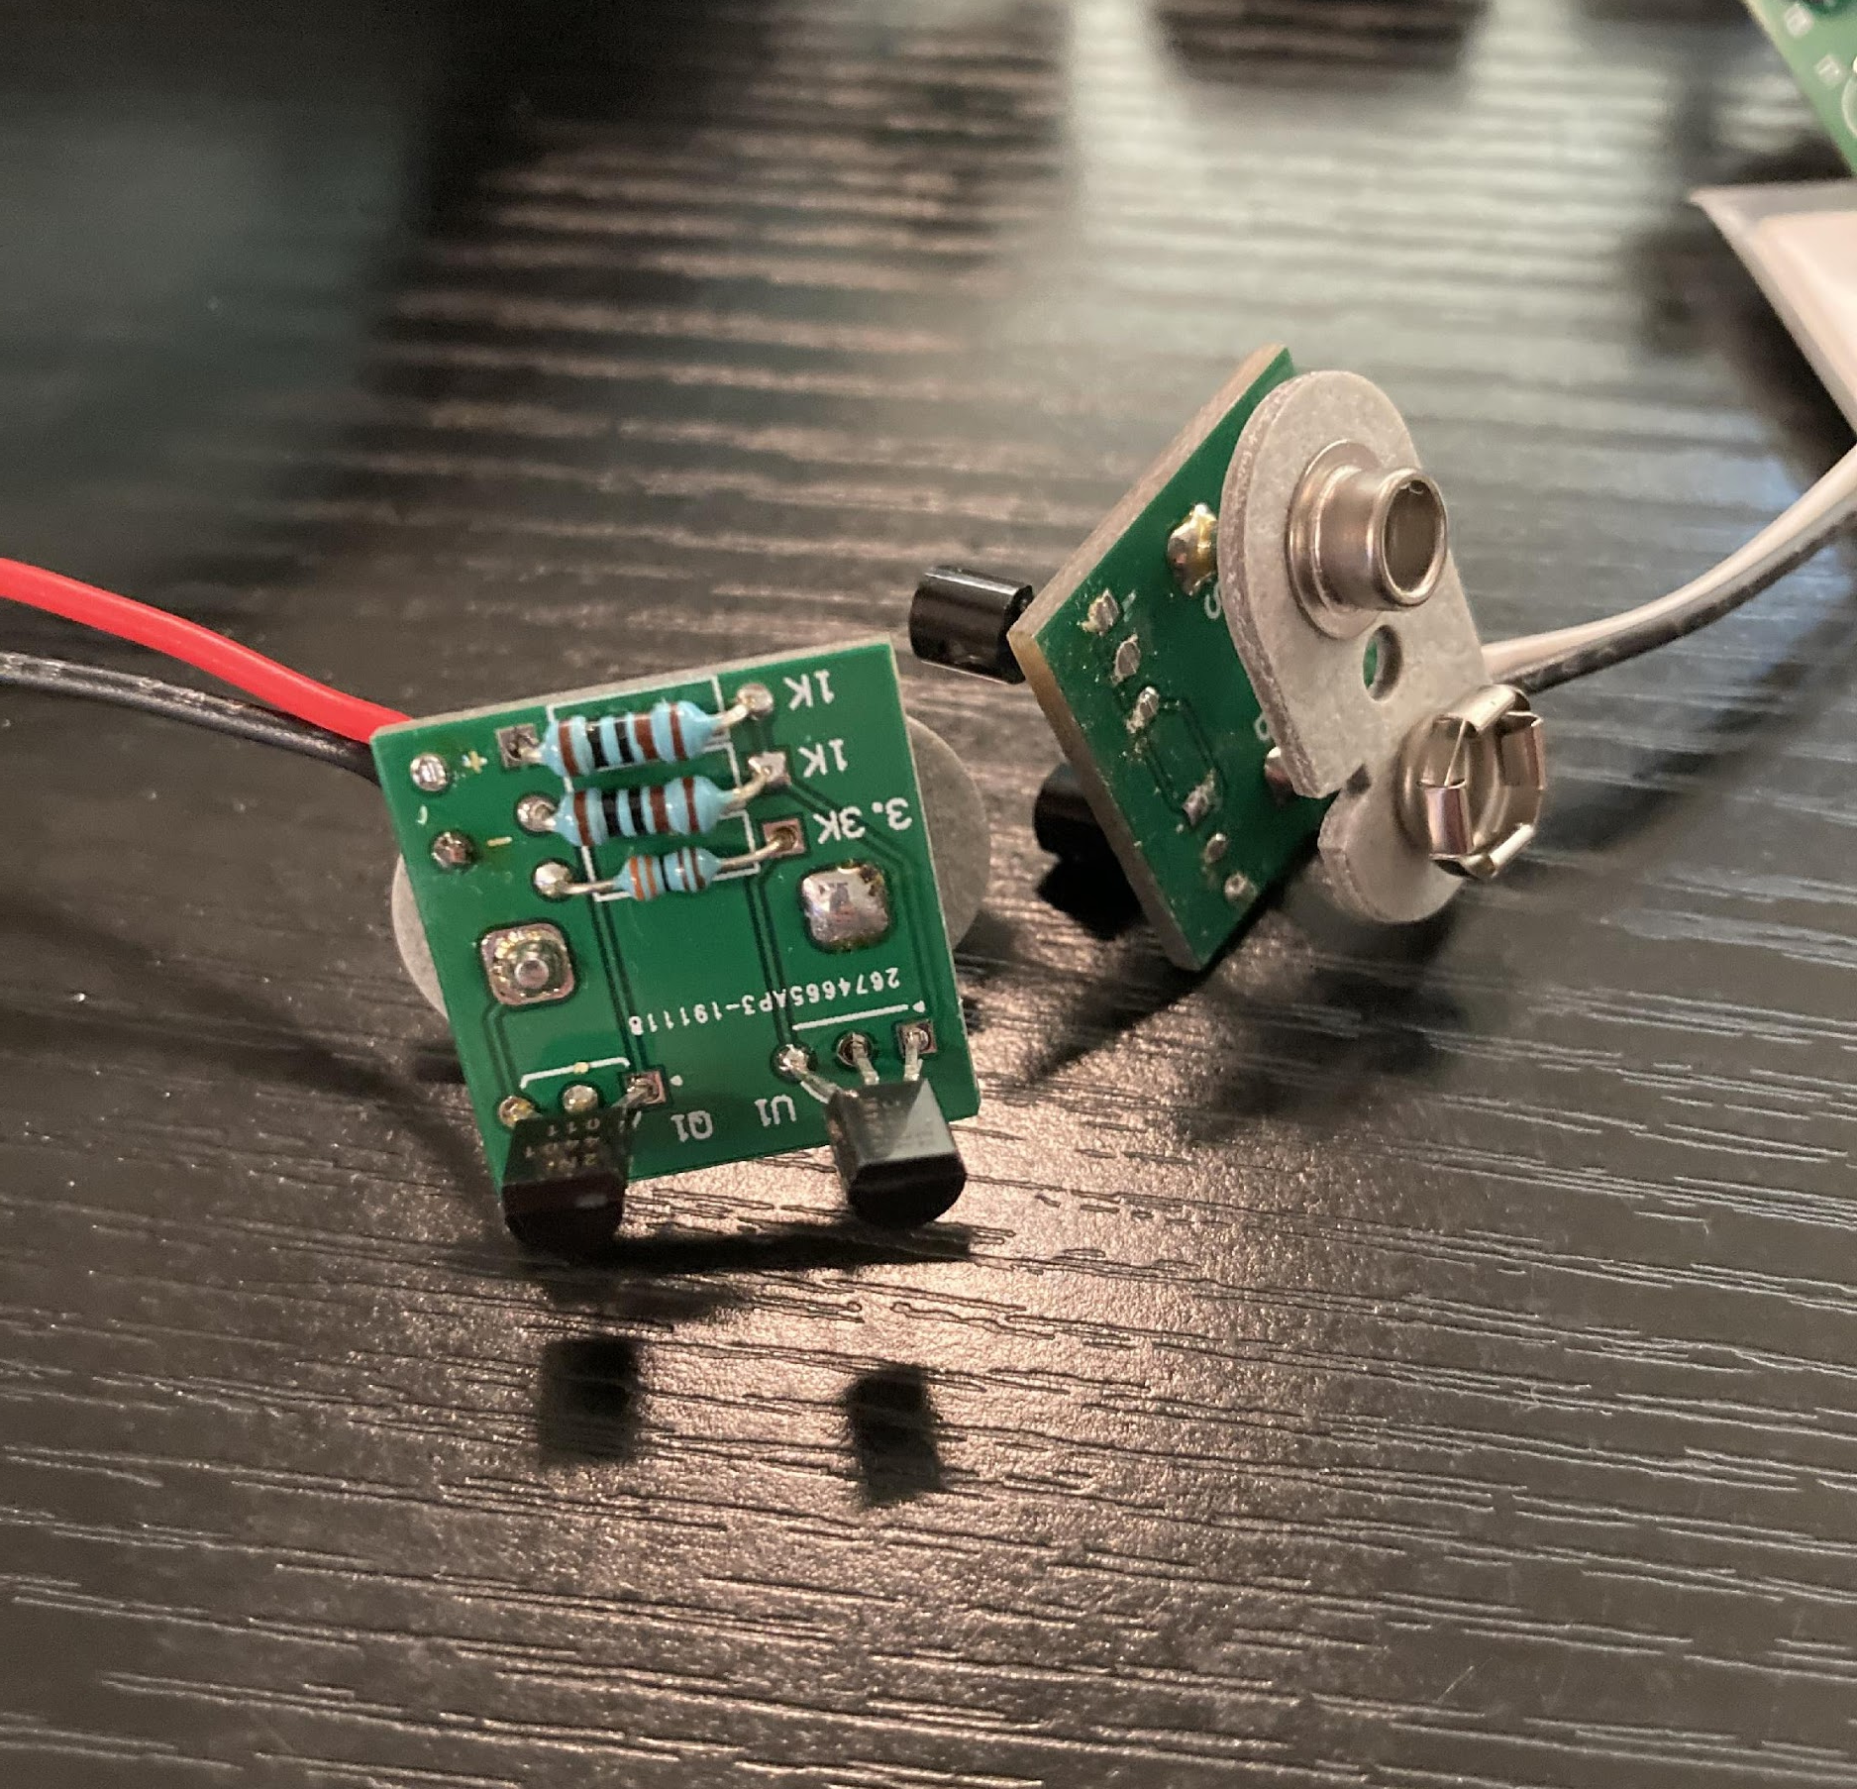
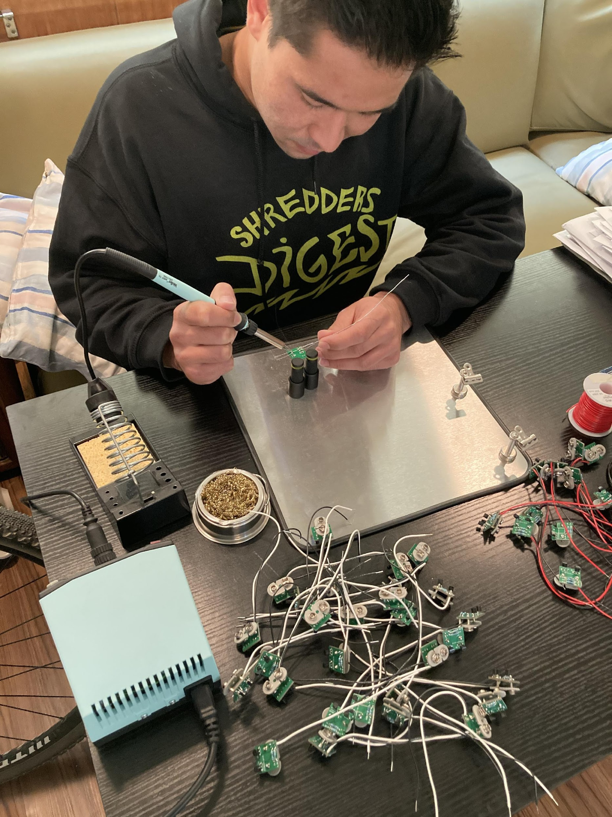
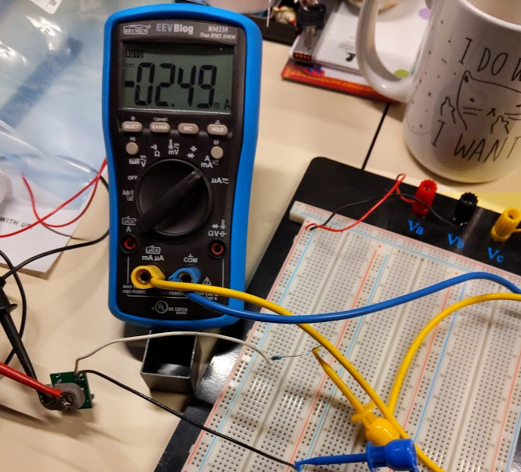
Initial Design
Prototype
Materials
Schematic Capture
Milled Assembly
Board Layout
Manufacturing
PCB Assembly
Packaging
Deployment
Improved Design
Impact
PCB Assembly

Slide 12
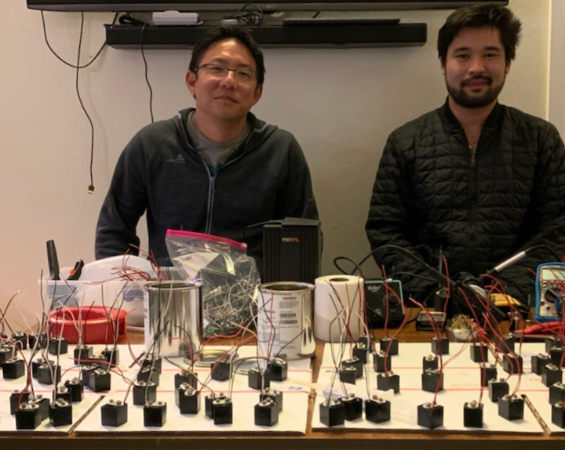
Initial Design
Prototype
Materials
Schematic Capture
Milled Assembly
Board Layout
Manufacturing
PCB Assembly
Packaging
Deployment
Improved Design
Impact
Packaging

Slide 13
Initial Design
Prototype
Materials
Schematic Capture
Milled Assembly
Board Layout
Manufacturing
PCB Assembly
Packaging
Deployment
Improved Design
Impact
Deployment
P-Blocks are ready to use:
Voltage Sources
Current Sources

Slide 14
Initial Design
Prototype
Materials
Schematic Capture
Milled Assembly
Board Layout
Manufacturing
PCB Assembly
Packaging
Deployment
Improve Design
Impact
Improved Design

Slide 15
Initial Design
Prototype
Materials
Schematic Capture
Milled Assembly
Board Layout
Manufacturing
PCB Assembly
Packaging
Deployment
Improve Design
Impact
Improved Design
Electronics Lab Kit:
2 Voltage Sources
2 Current Sources
Breadboard
Multimeter
Jumper Wires

Slide 16
Initial Design
Prototype
Materials
Schematic Capture
Milled Assembly
Board Layout
Manufacturing
PCB Assembly
Packaging
Deployment
Improved Design
Impact
Impact

Slide 17
Applied Mathematical Modeling Process
Power Blocks Support Website
http://www.appliedlinearalgebra.com/blog/for-teachers/linear-algebra-laboratory-exercises/power-blocks-project

